Slide 1
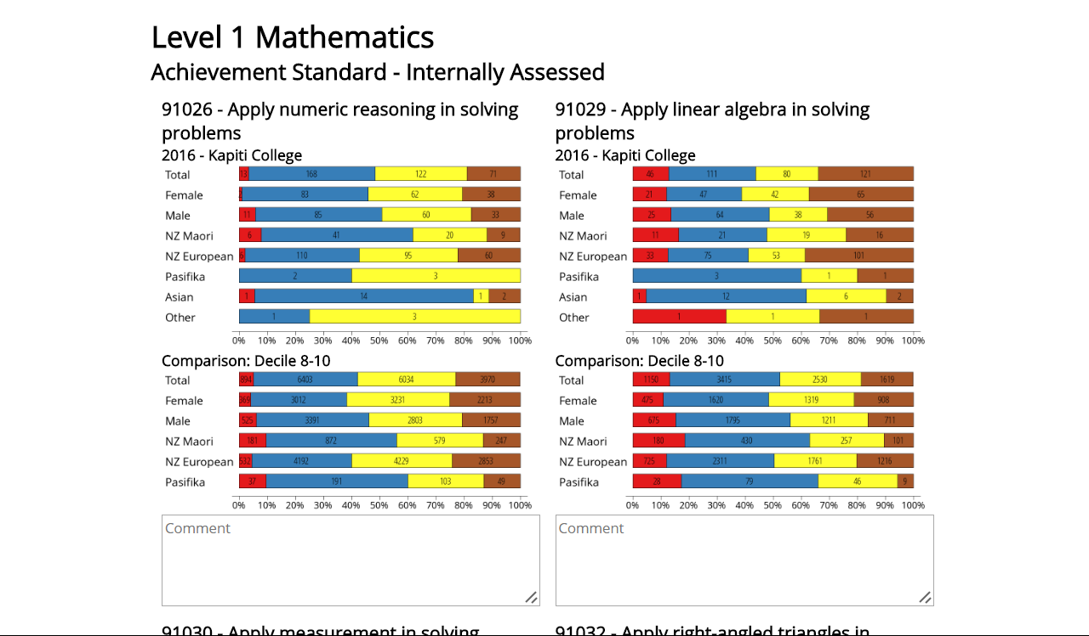
You want this? It’s easy…. Click through the instructions to see how

Slide 2
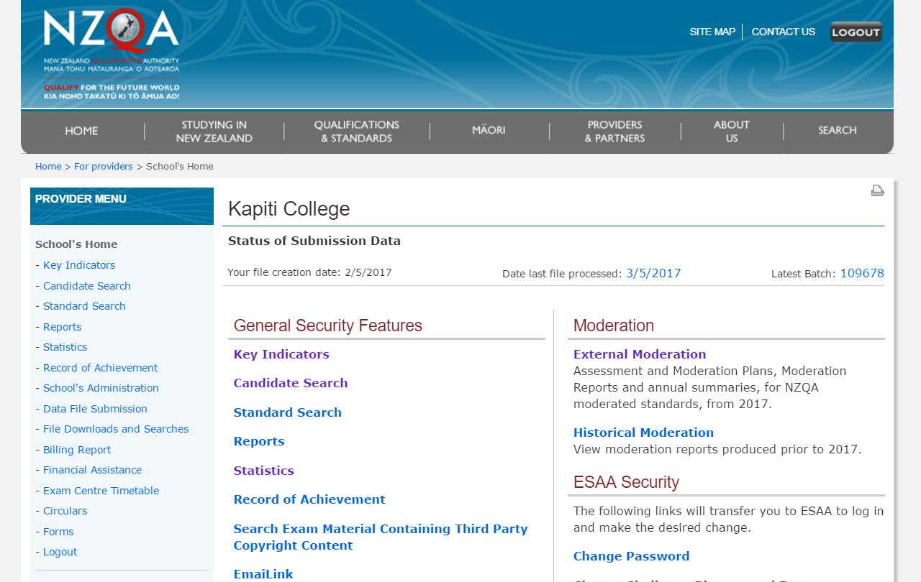
Click

Slide 3
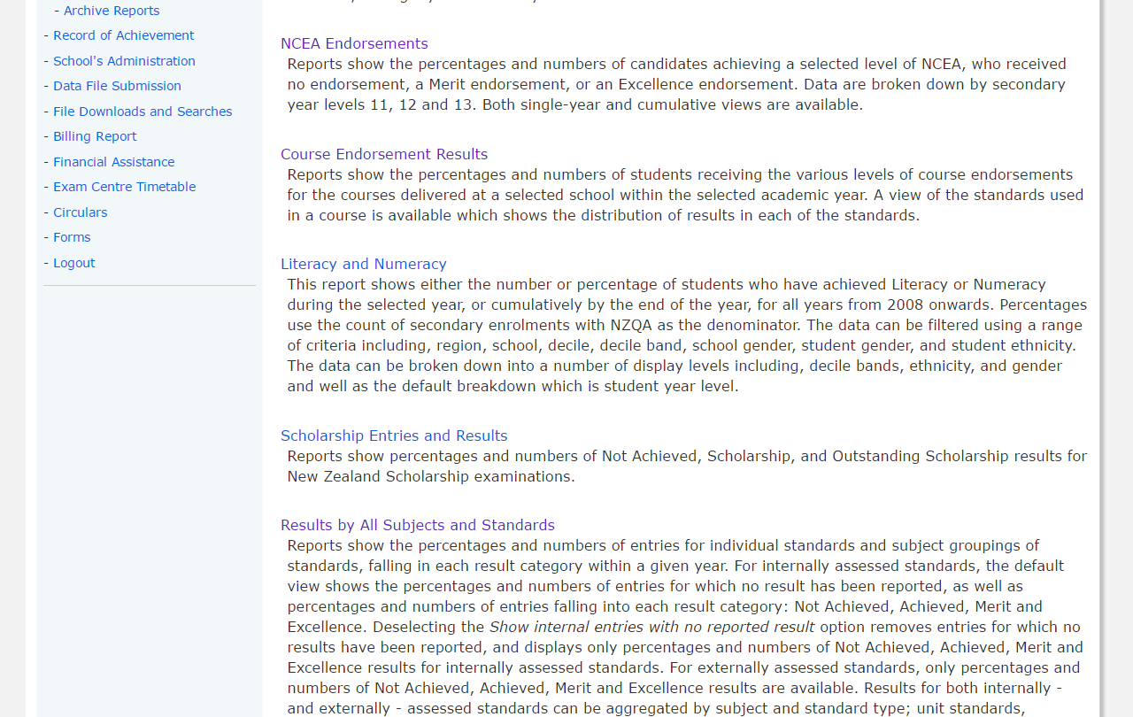
Click

Slide 4
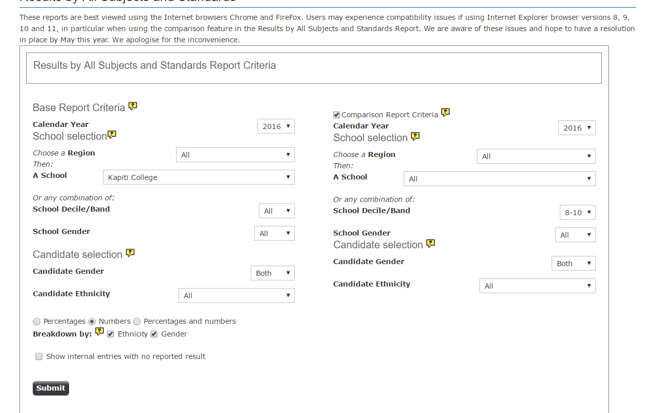
Tick
Your School
Choose
Choose Numbers
Tick Both
Last Step

Slide 5
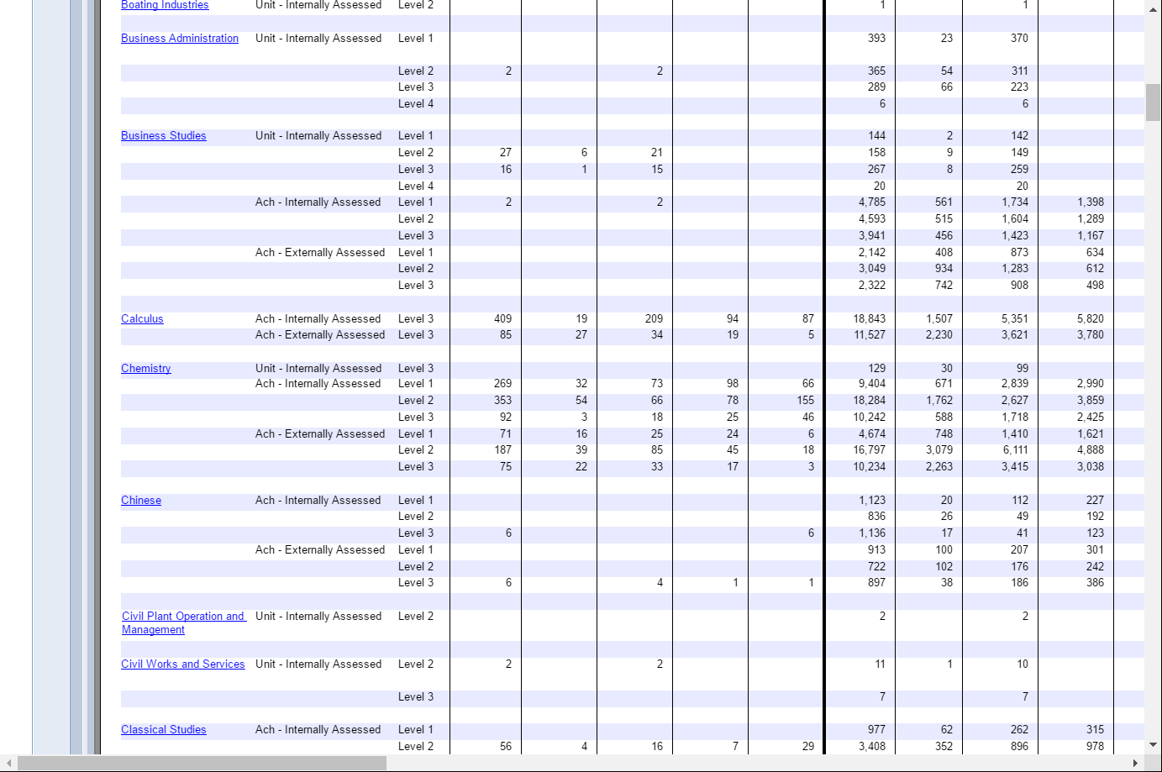
Click on a Subject

Slide 6
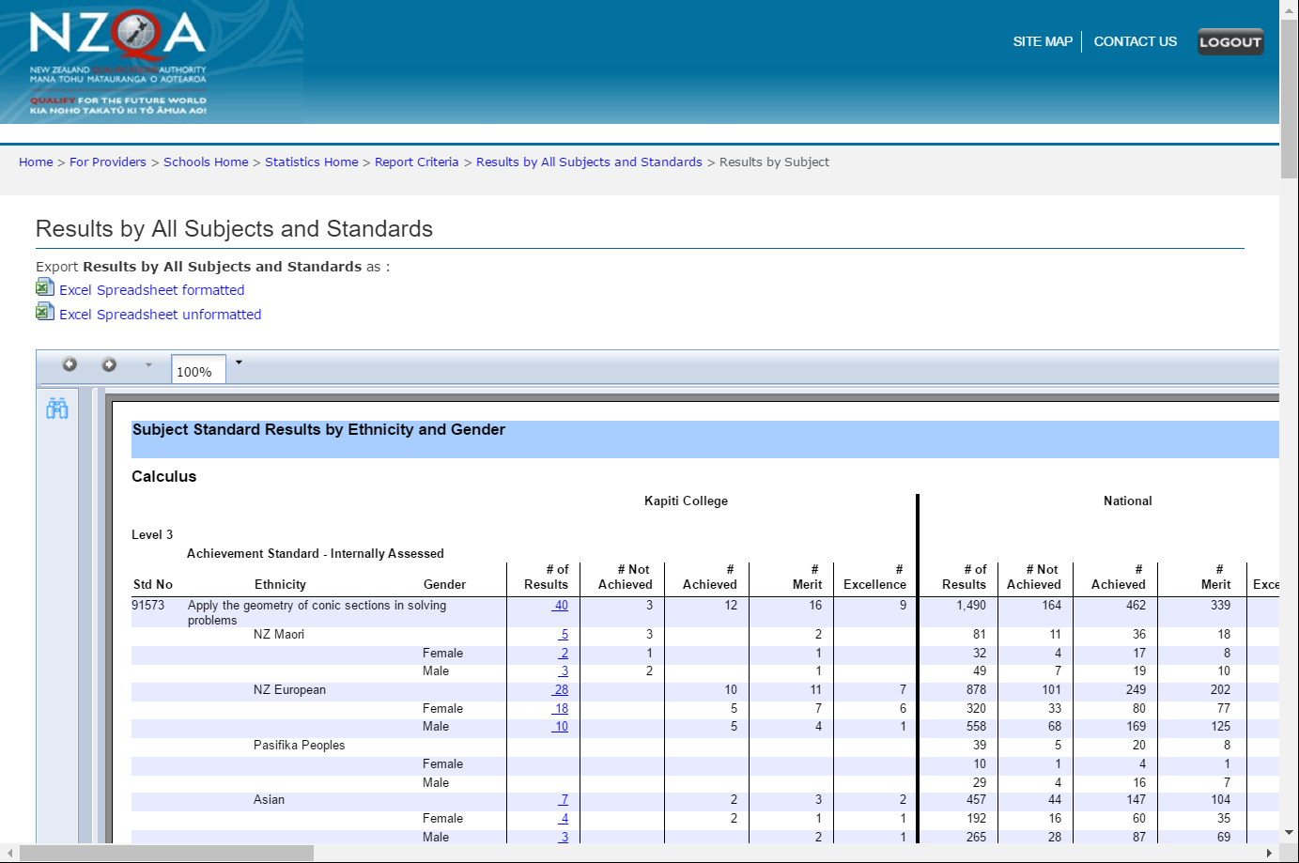
Then here to go back to all subjects… download as many subjects as you want
Click here first

Slide 7
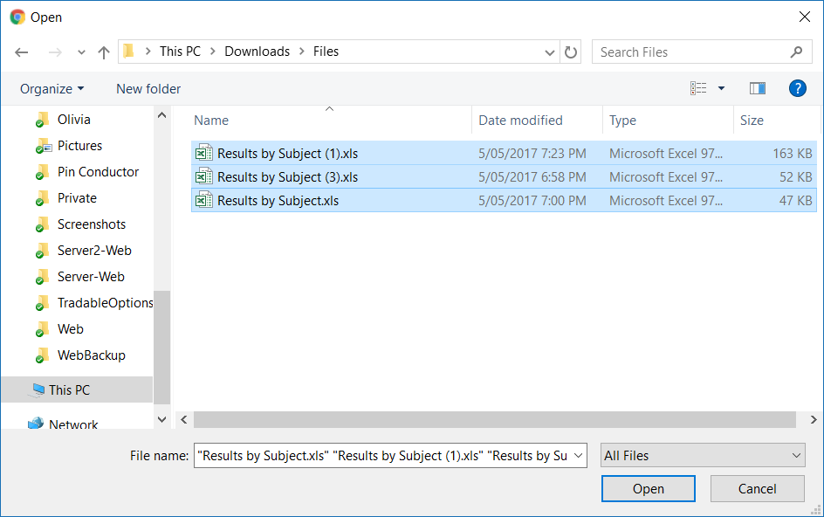
Click Here
Select one or more files (shift lets you click multiple next to each other, or ctrl (cmd on mac) lets you select them if they are not next to each other)
Click Here

Slide 8
And that gives you this…

